Slide 1
Weather-Influenced Sales Analysis
Exploring the impact of weather on Coffee Shop Sales
- By Naina Sonkar

Slide 2
PROJECT OVERVIEW
Weather-Influenced Coffee Shop Sales Analysis project explores how different weather conditions affect the sales performance of a coffee shops. The analysis helps identify sales trends, top-performing stores, and product preferences under changing weather conditions. By combining sales data and weather data, we uncover useful insights that will help business drive-decisions.
Tools Used: Python (Pandas, Matplotlib, Seaborn)

Slide 3
OBJECTIVES
Identify sales trend over time.
Understand how weather condition impact on sales performance.
Identify the best performing product categories on the basis of weather conditions and top performing weather based on total sales.
Analyze sales pattern by store locations.
Detect sales pattern in weekdays vs. weekends to inform marketing strategies.

Slide 4
DATA USED
Sales Data: date, transaction_qty, unit_price, total_price, store_location, product_category
Weather Data: Location, temp, conditions, date
Merged On: date and Location

Slide 5
Visual Insights
Sales Trend Over Time
Weather Impact On Sales
Sales by Product Category and Weather Conditions
Top Performing Store Locations
Sales by Week

Slide 6
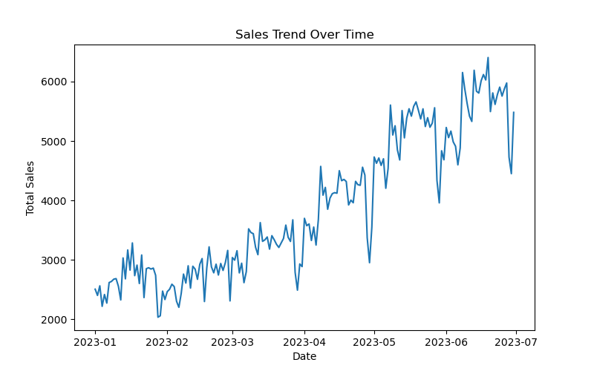
📈 Sales Trend Over Time
Insight:
Sales are growing continuously overtime, with some ups and down. It means business is doing well.
What we suggest:
Look at what caused those sales ups - Is that a sunny weather? Or a special offer or discount?
If yes, then try to repeat those ideas.

Slide 7
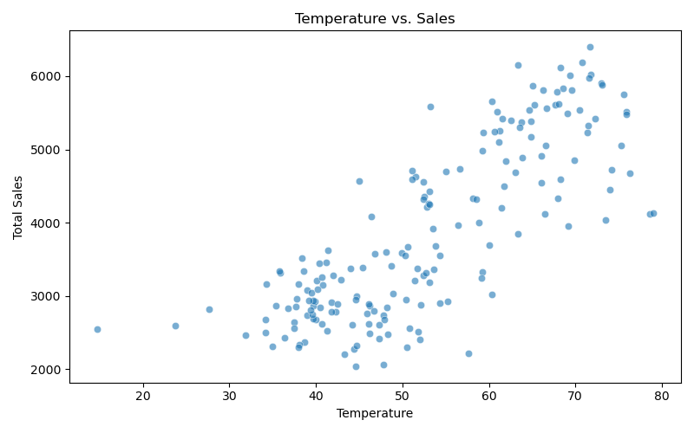
🌡️Weather Impact On Sales
Insight:
Higher temperature leads to higher sales volumes - there is positive correlation between temp and sales.
People buy more, probably want cold drinks on warm weather.
What we suggest:
Use weather forecast to prepare ahead and promote for cold drinks.

Slide 8
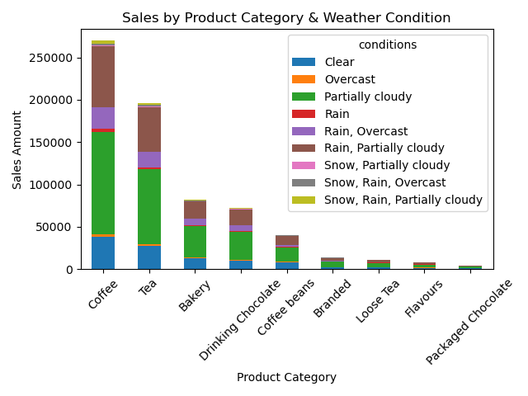
🌤️ Sales by Product Category and Weather Condition
Insight:
Coffee and tea sells most especially when it’s partially cloudy and rainy days.
Partially cloudy is the top performing weather by sales.
What we suggest:
Keep extra stock of top selling product.
Boost the sales of other product by offering combos like “Coffee + Brownie”.

Slide 9
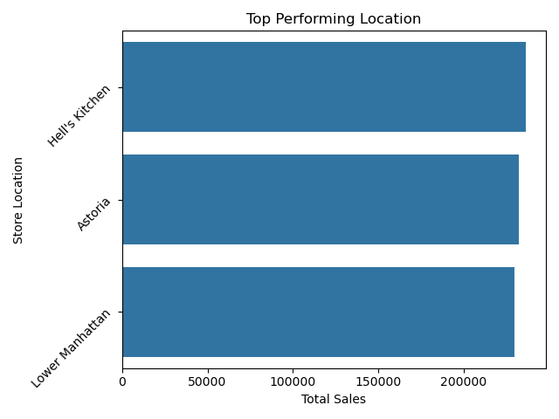
📍Top Performing Store Location
Insight:
All the location are close on total sales, but Hell’s Kitchen is leading.
What we suggest:
Figure out what’s happening in Hell’s Kitchen and apple it to the other branches.

Slide 10
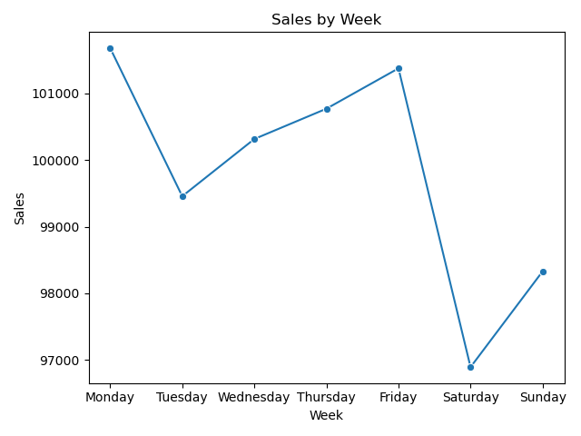
📅Sales by Week
Insight:
Sales are strong on weekdays(Monday-Friday), as compared to weekends.
Weekdays might attract office workers.
What we suggest:
Try running offers or discounts on weekends to boost more weekend customer.

Slide 11
Final Recommendations:
Use Weather Forecast for promotions
Plan daily offers (like cold drink discounts on summers or a special offer on bakery products), and keep extra stock for top performing product when sunny and rainy weather is forecasted.
Create product combos
Offer value combos like “Coffee + (baked item)” to increase avg billing or cross-selling.
Plan for Weekend Sales
Weekdays have more sales, attract more weekends customers with offer, live music or
special discount.
Boost Other Locations
Look what’s happening in the Hell’s Kitchen and apply it to the other locations.
Focus on Customer Behaviour
Collect feedback or run a small survey on customers favourites in different weather, then advertise them on the basis of their favourite items.

Slide 12
Thank You!

